Slide 1

Using machine learning to predict weather changes: final presentation to climateWins
By: Ayodeji Abdulfatai Oyinloye – ClimateWins Trainee in Machine Learning
Date: 30.05.2025

Slide 2

Objectives of the project
ClimateWins has the following goals:
Identify weather patterns outside the regional norm in Europe.
Determine if unusual weather patterns are increasing.
Generate possibilities for future weather conditions over the next 25 to 50 years based on current trends.
Determine the safest places for people to live in Europe over the next 25 to 50 years.

Slide 3

Thought experiments on the objectives – option 1
Use historical and current information on known important weather features to determine trends, find average per feature and detect anomalies. Anomalies to be visualized on European map to localize events.
Trend analysis of increasing extreme features using the 1960 – 2022 dataset. Use of statistical testing or machine learning to quantify trends and predict their persistence and charts to display anomalies frequency over decades.
Long-term weather scenario forecasting leveraging suitable climate model outputs and machine learning in Python to simulate future weather conditions – 2025 to 2050 and 2050 to 2075. This will be combined with spatial analysis to identify areas with stable weather features behaviour.

Slide 4
Thought experiments option 1 – parts to the whole.
The thought experiments here are complementary elements fitting into a whole project and not alternatives:
Anomalies detection analysis is aimed at objective 1 – pinpoint “unusual” weather events (extreme heat, heavy rainfall, etc.)
Trend analysis of unusual weather patterns satisfies objective 2 – determine if the ‘unusual’ is becoming increasingly regular
Long-term weather scenario forecasting satisfies objectives 3 and 4 – generate future weather possibilities and identify safest places to live.

Slide 5
Thought experiments options 2 and 3
The thought experiments here could be alternatives to option 1 and offer some uniqueness:
Option 2 – regional weather patterns clustering – can address objectives 1 and 4 to determine unusual weather patterns and safer regions
Option 3 – predictive classification of extreme/unusual weather events – can address objectives 2 and 3 to quantify trends of unusual weather patterns and generate future scenarios

Slide 6
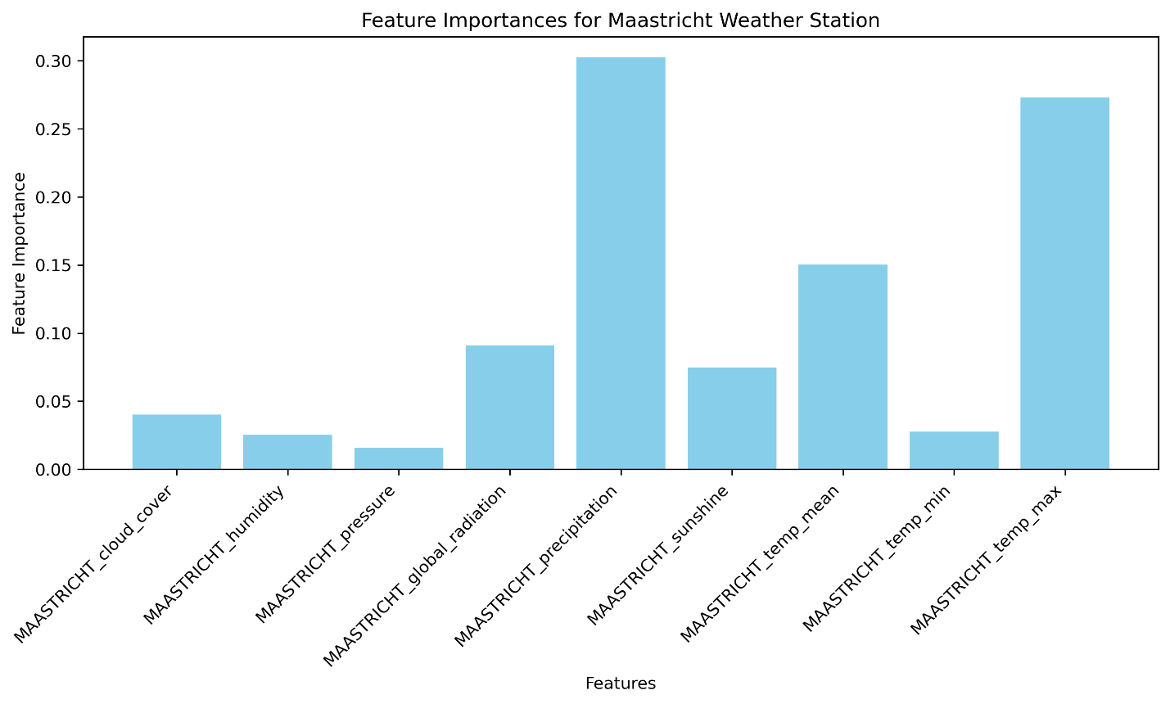
Option 1 - Anomalies detection and trends analysis
Exhaustive historical weather data to be available, cutting across all units of European climate categories
Classification algorithms in Python can then be used to categorize weather features tendencies over history, generate average and use of spatial dataset to visualize these patterns continentally
Time-series analysis machine learning models in Python can then be used to determine if the intensity of unusual weather events are increasing (typhoon, hurricane, draughts, etc.)
Right hand-side visual shows a chart of features importance in weather data using an ensemble random forest model for a European weather station

Slide 7

Option 1 – long-term scenario forecasting
We also need synthetic climate models datasets which can simulate the interactions of the important drivers of climatic events (precipitation, temperature, atmosphere, etc.)
An example of these mathematical models is CMIP6 – Coupled Model Intercomparison Project Phase 6
The mathematical models can be linked with either ensemble random forest or neural network in Python to generate probabilistic weather scenarios for the next 25 to 50 years
European spatial dataset will again be used at this stage to isolate safest regions with friendly weather events
Visual is an example of real-life weather conditions (cloudy) that may be simulated at this stage with option 1

Slide 8
Thought experiment Option 2
Summary:
Develop unsupervised machine learning model in Python (e.g., k-means clustering or Gaussian Mixture, using scikit-learn) to group European weather regions on the historical weather data with the current features.
Identify clusters with similar weather behaviours and detect outliers representing unusual patterns (e.g., extreme storms, etc.)
Visualize clusters on a map to highlight regions with stable vs. erratic weather to identify safer areas less prone to extremes
Validate the clusters with silhouette scores or domain expertise to ascertain reliability of the clusters
Combine with statistical summaries to quantify feature differences between clusters (e.g., variance in precipitation, etc.)
Feasibility:
Can use the available historical dataset/enriched version with rich Python libraries and good for displaying bright and identifiable regional insights
Output:
A map of clustered regions with a table summarizing clusters characteristics
Uniqueness:
This option focuses on spatial grouping rather than temporal trends, offering a complementary tangent on anomaly detection

Slide 9
Thought experiment Option 3
Summary:
Develop a supervised machine learning model in Python (Random Forest, XGBoost, etc.) to classify and predict extreme weather events using the available/or enriched historical data with current features.
Train the model to identify conditions leading to extreme weather events and access the likelihood of events increase over time – trend analysis
Compile the feature importance to highlight key drivers of extreme events (e.g., changes in precipitation, max. temperature, etc.)
Generate probabilistic predictions for 2025 – 2075 using synthetic future data from climate models (e.g., CMIP6).
Visualize results with a chart showing predicted event probabilities over time
Feasibility:
Utilizes available weather datasets and robust Python libraries and can present actionable risks assessments
Output:
A chart of predicted extreme event probabilities and a table of key weather features that impact them
Uniqueness:
Emphasizes classification of specific event types and can be a complement of the broader scenario forecasting of option 1.

Slide 10
Preference for option 1
Advantages of Option 1:
Cohesive flow: the experiments follow a logical progression: identify anomalies → analyze their trends → predict future conditions and safe zones. This creates a clear storyline, showing how machine learning can move from understanding the present to forecasting the future
Shared data and tools: all three parts can use similar datasets (the historical weather dataset, synthetic weather model such as CMIP6) and Python tools (e.g., pandas, scikit-learn, TensorFlow), making them practical to implement as a unified project
Comprehensive Coverage: together, they address all four objectives, ensuring coverage of the full scope of the project goals
Feasibility/Resources:
clustering models like DBSCAN or isolation forests will be used to analyze the historical weather dataset and identify extremes by comparison with long-term regional averages (for instance, a 30 –year baseline)
Spatial data of Europe will be used to visualize and localize areas with unusual weather events
time-series models (e.g., ARIMA or LSTM / RNN) on the weather dataset will help determine the trends in frequency or intensity of anomalous weather events over time
Synthetic climate models (e.g., CMIP6 datasets) and machine learning (e.g., neural networks or ensemble models in Python) to simulate future weather conditions in Europe for 2025 –2075 based on current trends
Output:
cohesive analysis of current and future European weather patterns, delivering a map of detected anomalies, a chart of increasing extreme weather trends, and probabilistic future scenarios identifying safer regions for 2025 – 2075

Slide 11
next steps
Refine Model: Optimize DBSCAN or isolation forest parameters using scikit-learn to enhance anomaly detection accuracy.
Expand Dataset: Incorporate additional ECMWF or Copernicus variables into the existing historical dataset (e.g., any important feature that may be currently unavailable) for richer insights.
Visualize Results: Develop interactive maps with matplotlib/seaborn for presentation impact.
Integrate Alternatives: Explore trend analysis (Option 2) and forecasting (Option 3) to build a comprehensive narrative – if time and other resources permit.
Validate Findings: Cross-check anomalies with meteorological expertise and statistical tests

Slide 12

The end!
Contact: ayooyin2003@yahoo.com ; LinkedIn
My GitHub page for this project is: ay104/climatewins_repo: machine learning weather prediction by climateWins
Portfolio website: https://www.ayooyinloye104data.com
Thank You!
Thank You!

